Slide 1


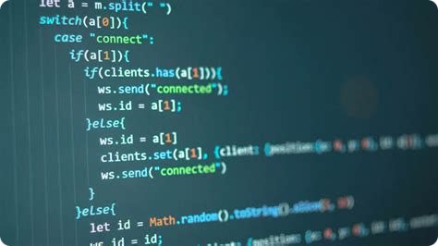

Introduction to JavaScript
TEAM MEMBERS :
Arpita Nath - 2251188 , 12622001035
Asmit Paria - 2251044 , 12622001042
NAVEEN KUMAR - 2251236- 12623001
Naveen Kumar - 2251236 , 12623001206
Antik Adhya. - 2251234 , 12623001195

Slide 2
Variables and Data Types
Variables
Data Types
Naming Conventions
Variables are used to store data values.
Primitive Types: Number[positive, negative, integers, floating numbers], Boolean, String, Undefined, Null, Bigint, Symbol.
Following best practices for variable naming, such as using camelCase, makes your code more readable and maintainable.
var: Function-scoped variable.
let: Block-scoped variable.
Complex Types: Object, Array
const: Block-scoped, read-only variable.

Slide 3

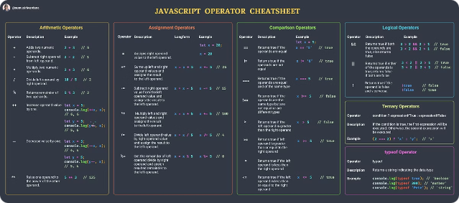
Operators in JS
Arithmetic Operators
Assignment Operators
Comparison Operators
Logical Operators
Unary Operators

Slide 4
Conditionals Statements and Loops)
Conditionals
1
Use if-else, else if statements to execute different code based on specific conditions.
2
Switch Statements
Provide a more concise way to handle multiple conditions in a single block.
Loops
3
Iterate over blocks of code, such as for, for-of, for-in, while, and do-while loops.

Slide 5

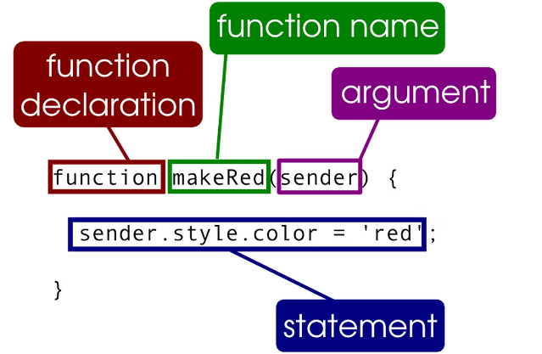
Functions
Defining Functions
Parameters and Arguments
Return Statements
Arrow Functions

Slide 6

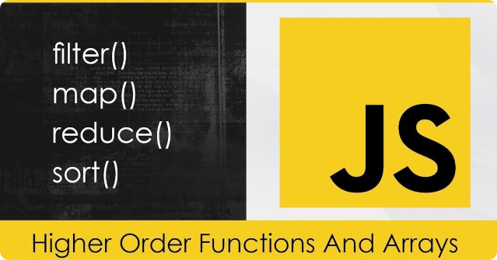
Arrays
Adding Elements : Push, unshift, and splice to add new items to an array.
Removing Elements : Pop, shift, and splice to remove items from an array.
Accessing Elements : Use index values to retrieve and manipulate individual array items.
Iterating Arrays : Loop through arrays using methods like forEach, map, and filter.

Slide 7
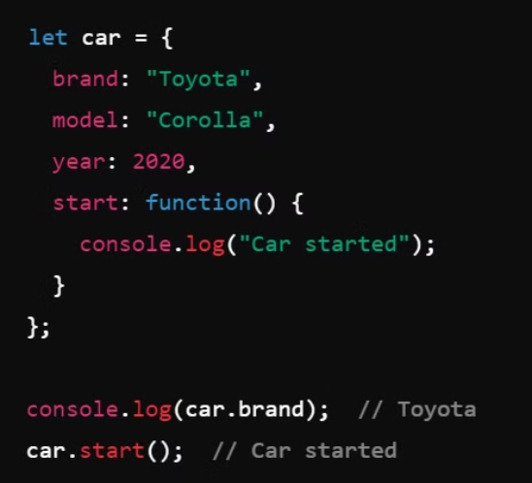
Objects
Objects are collections of key-value pairs.

Slide 8

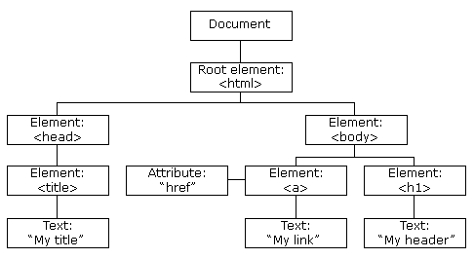
DOM
The DOM allows JavaScript to dynamically interact with and modify the content and structure of a webpage, enabling the creation of interactive and dynamic user experiences.

Slide 9

THANK YOU

